Slide 1
Performance Evaluation System
Part IV: Senior Reporting Officials

Slide 2
Agenda
Reporting Official Profile Trends
Boardroom Feedback
Profile and MBS Integration
Teaching Junior Officers
Third Officer Sighter Responsibilities

Slide 3
Reporting Official Profile Trends

Slide 4
RS Trends
Writing to a profile
Writing to specific relative values (RV)
Giving everyone the same value
All of the following profile examples are real profiles.

Slide 5
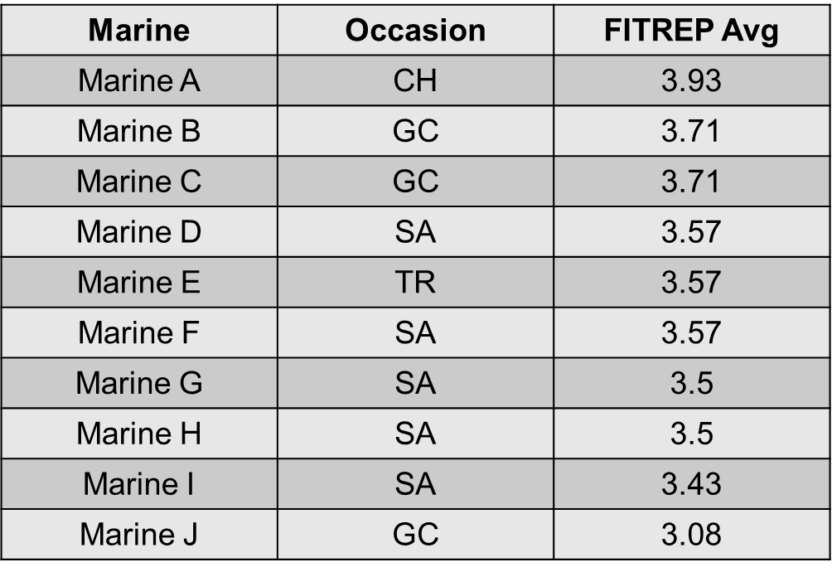
Writing to a Profile
Example Profile (Writing to a profile):

Slide 6
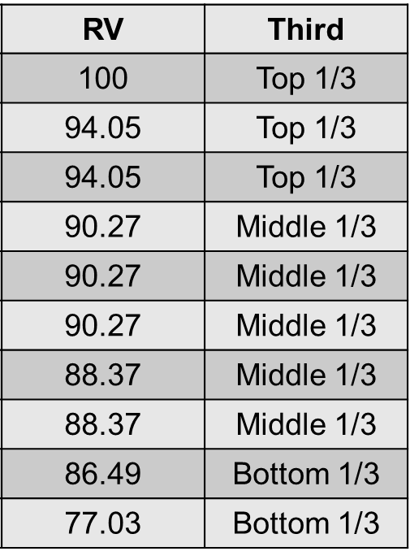
Writing to a Profile Cont.
What the board sees:
Not an issue here
This is the problem!
-A single attribute separates the two RV groupings.
-They all look the same to a promotion board
Not an issue here

Slide 7
Writing to a Profile Cont.
Example Profile (Marking Philosophy)
Marine | Occasion | FITREP Avg
Marine A | CH | 4.23
Marine B | CH | 4.23
Marine C | CH | 3.61
Marine D | AN | 3.53
Marine E | CH | 3.46
Marine F | CH | 3.46
Marine G | TD | 3.38
Marine H | AN | 3.15
Marine I | CH | 3.07
Marine J | CH | 3.07
Marine K | CH | 2.92
Marine L | AN | 2.84
Marine M | CH | 2.76
Marine N | GC | 2.53

Slide 8
Writing to a Profile Cont.
Comparison of what the board sees:
RV | Third
100 | Top 1/3
100 | Top 1/3
93.26 | Middle 1/3
92.39 | Middle 1/3
91.63 | Middle 1/3
91.63 | Middle 1/3
90.76 | Middle 1/3
88.26 | Middle 1/3
87.39 | Middle 1/3
87.39 | Middle 1/3
85.76 | Bottom 1/3
85.30 | Bottom 1/3
84.02 | Bottom 1/3
81.52 | Bottom 1/3
Look at the middle 1/3 of each profile—which one provides beneficial information for making close decisions?
Notes:
-Compare the middle 1/3 of each of the profiles. Accentuate the quality spread in the “marking philosophy” profile
-The argument that the “Marking Philosophy” profile looks better because it has more reports in it is not a supportable argument. Historical data clearly shows that the longer someone writes to a profile the more narrow it becomes—meaning, reports get closer together and more are stacked on top of one another.

Slide 9
Writing to a Profile Cont.
Boards spend most of their time trying to select amongst the middle 1/3
When quality spread is non-existent, then everyone looks the same
Boards don’t see an RS’ entire profile, they only see single reports
Amplify the previous profile with bigger profiles, and integrate thousands of profiles—now picture yourself on the board and trying to use that data to break Marines out!

Slide 10
Writing to a Profile Cont.
Our system is dependent upon quality spread
Without quality spread, our current evaluation system is not sustainable

Slide 11
Writing to Specific RV’s
The numbers in MOL are rounded to two decimal places, the numbers used to actually calculate the profile numbers are not
The math will be off
By the time the MRO is on a board, the number will most likely have changed

Slide 12
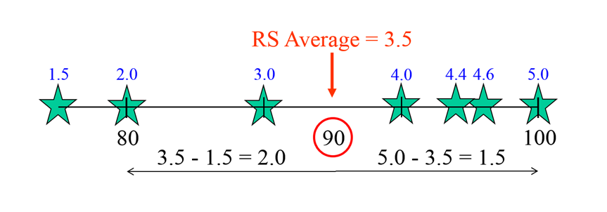
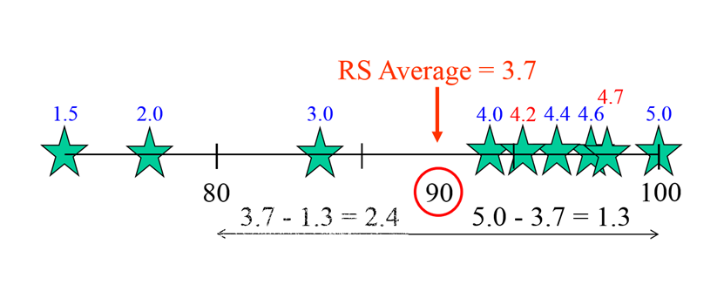
Writing to Specific RV’s Cont.
Example:
This report was written so that it just made it into the top 1/3 of the RS’ profile.
This is the same report, the only difference is that the RS wrote two more reports above the RS average. The report is now a middle 1/3 report.
Note: The thirds were established so that board members could quickly identify the potential of a fitness report, not as a way for a RS to tell the board who to promote.

Slide 13
Giving Everyone the Same Value
Marine | Occasion | FITREP Avg
Marine A | AN | 5.14
Marine B | AN | 5.14
Marine C | CH | 5.14
Marine D | GC | 5.14
Marine E | TR | 5.14
Marine F | TR | 5.14
Marine G | TR | 5.14
Marine H | TR | 5.14
Marine I | AN | 5.14
Marine J | AN | 5.14
Marine K | TD | 5.14
Marine L | AN | 5.14
Marine M | CH | 5.14
Marine N | TR | 5.07
Marine O | AN | 5.07
Marine P | CH | 5.07
Marine Q | CH | 5
Marine R | AN | 4
Example:

Slide 14
Giving Everyone the Same Value Cont.
RV | Third
100 | Top 1/3
100 | Top 1/3
100 | Top 1/3
100 | Top 1/3
100 | Top 1/3
100 | Top 1/3
100 | Top 1/3
100 | Top 1/3
100 | Top 1/3
100 | Top 1/3
100 | Top 1/3
100 | Top 1/3
100 | Top 1/3
91.25 | Middle 1/3
91.25 | Middle 1/3
91.25 | Middle 1/3
82.5 | Bottom 1/3
42.5 | Bottom 1/3
What the board sees:
Do the numbers help
help a board break
Marines out?
What if every reporting
official did this?

Slide 15
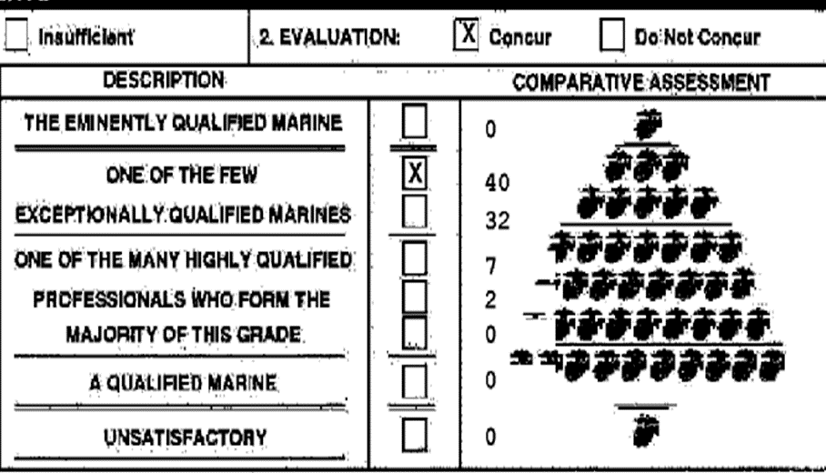
RO Trend
72 of the 81 reports are split between two blocks.
Lumping
Do the numbers help a board break Marines out?

Slide 16
Boardroom Feedback

Slide 17
What Board Members Say
Comments do not match RV breakout
The most consistent complaint
RV is not breaking Marines out of the pack
RS’ are not writing to the board

Slide 18
Comments Do Not Match RV Breakout
Why?
Reporting officials write to a profile
Reporting officials are giving clusters of Marines the same value

Slide 19
RV Is Not Breaking Marines Out Of The Pack
Why?
Reporting officials profiles are too narrow due to writing to a profile
Reporting officials are giving clusters of Marines the same value

Slide 20
RS’ Are Not Writing To The Board
Why?
PES training is not effective
Past board members are not educating their commands on proper comment writing

Slide 21
Profile and MBS Integration

Slide 22
Master Brief Sheet: A Boardroom Tool
When you subtract the RS’ Avg from the RS’ High, and then multiply that number by 2, you get the range of the RS’ profile.
Attribute marks break out the MRO’s potential areas of weakness/strength
REPORTING SENIOR MARKINGS
Reporting Senior
Per
Pro
Cou
Eff
Ini
Lea
Dev
Set
Ens
Co
PME
Dec
Jud
Eval
Promote
Reports
RPT Avg
RS Avg
RS High
RPT at High
RV at Proc
Cum RV
LtCol Stickler
C
C
B
B
C
C
B
C
C
B
B
B
C
H
Yes
14 of 17
2.53
2.25
2.82
1
94.60
96.00
LtCol Smidgen
C
C
C
H
C
C
H
C
H
B
H
C
C
H
Yes
8 of 8
2.88
2.93
3.50
1
89.76
89.76
LtCol Highmark
E
F
E
D
E
E
D
D
D
D
E
E
E
H
The number of reports at the RS High is an indicator for skewed profiles.
Yes
3 of 5
4.69
4.94
5.23
2
83.70
81.38
LtCol Solo
B
B
C
B
B
C
B
B
C
B
B
C
B
H
Yes
1 of 1
2.30
2.30
2.30
1
NA
NA
Reports column provides details about the potential reliability of the RS’ profile.
The RS Avg column tells you which attribute constitutes an average attribute mark for the associated RS profile.
Notes:
22
1. Attribute Marks: Being able to break out a Marine’s strength and weaknesses is critical to the selection process. Additionally, it is the only
reason that attribute marks are on the MBS.
2. RS Profile Size: RS profiles are not created equal. RS profiles can be small, large, accurate, skewed, expanded, narrow, etc…RS profiles
have a direct correlation with relative value. If you are going to assume that the relative value of a report is accurate, then you HAVE to ensure
that the data feeding relative value is accurate. If an RS’ profile is small, narrow, or skewed, then the RV of the fitness reports in that same
profile is going to be highly unreliable. That is important to know when you are making general assumptions about the metrics that a specific
report is giving you.
3. RS Avg: The only way to know the worth of an attribute mark is to know if it is a below average, average, or above average mark for the RS.
Before you can know if something is below average or above average is to first know what average is. Since RS marking philosophies are not
standardized, you have to find the average for each RS. The RS’ Avg column gives you that information. Given the numerical values of each of
the grades you can assign an attribute (A =1, B=2, C=3, D=4…), you can figure out an RS’ marking philosophy. (e.g., LtCol Stickler’s RS Avg
is 2.25; that means on any given report within the provided profile LtCol Sticker assigned 3/4 of the attribute marks the letter grade B, and the
other 1/4 the letter grade C). If LtCol Stickler assigned an attribute mark of E to a fitness report in the above profile, that mark should stand out to
anyone who sees it on the associated Marine’s MBS. As with all things related to fitness reports, a single high attribute mark for judgement does
not mean that a Marine’s judgement is superior to their peers. If over multiple reports the MRO’s marks for judgement are superior to their
peers, then it would be safe to assume that the MRO’s judgement is actually superior to their peers.
4. Profile Range: One of the quickest ways to determine if RV is completely unreliable is to find the range of an RS’ profile. Narrow profiles,
generally ranging from .4 to 1, are most often inaccurate profiles that project unreliable RV’s. The reason that narrow profiles project inaccurate
RV’s is because the profiles do not show quality spread—they simply show if one Marine is higher than another Marine in a specific profile. The
PROBLEM with that is that boards members do not look at a single RS’ profile—they NEED quality spread.
5. RPT’s at High: Multiple reports at the RS High can GREATLY skew an RS’ profile. It is critical that a board member be able to identify
a skewed profile. If you see a number larger than one in the RPT at High box, be mindful that RV may not be accurate. The higher the number
the higher the likelihood that the report’s RV is unreliable.

Slide 23
Teaching Junior Officers

Slide 24
Education
Education for junior officers at the command level is non-existent
An officer’s first duty station is the optimal time to provide PES education
Too many experts sharing their biased opinions on how they believe the evaluation system should work
Formal education will only succeed if commanders want it to succeed

Slide 25
Education Opportunities
Request PES training from MMRP
Navigate your Marines to the PES briefs on the MMRP-30 website (videos forthcoming)
Ensure that the officers in your command are attending the MMRP roadshow briefs
Seek out opportunities for your Marines to sit on boards
Ensure that officers conducting PES training contact MMRP for clarification and explanations

Slide 26
Education Cont.
The primary purpose of fitness reports is to assist promotion/selection/retention boards with making decisions
The outlined trends are in direct confliction with their designed purpose
Senior officers make up the majority of board representatives
As senior officers, poor fitness report writing is making your job more difficult
If the previous trends persist, you too will be complaining about the usefulness of FITREP data for its intended purpose
Our current PES system cost approximately $20 million. If we do not learn to use it as designed it will quickly out-live its effectiveness.

Slide 27
Third Officer Sighter Responsibilities

Slide 28
RS Responsibilities
Read chapter 5 of MCO 1610.7 (PES Order)--it covers adverse reporting procedures and is ONLY 10 pages in length
Must route the report to the Marine Reported On (MRO) for at least five business days for rebuttal and/or signature
If the MRO does not sign the report, make a directed comment in section I stating that the MRO refused to sign the report

Slide 29
RO Responsibilities
Read chapter 5 of MCO 1610.7 (PES Order)--it covers adverse reporting procedures and is ONLY 10 pages in length
Must adjudicate each and every claim made by the MRO that:
Disagrees with the RS’s version of the facts
Adds new information not addressed by the RS
If the RO adds additional adversity, OR adjudicates the MRO’s rebuttal to the RS, the report must be routed to the MRO for at least five business days for rebuttal and/or signature
Any comment that specifically addresses a statement made by the MRO is considered an adjudicative statement
NOTE: APES will force you to route the report to the MRO if Section K is being marked sufficient—even if neither the two situations above are relevant to the report
If the MRO does not sign the report, you are required to make a directed comment in section K stating that the MRO refused to sign the report

Slide 30
Third Officer Sighter Responsibilities
Enlisted Reports
The third officer sighting the report will be the commanding officer or executive officer at the battalion or squadron level, or a field grade officer or civilian equivalent within the chain of command that is at a higher level of command
Ex: The Regimental/Group CO/XO
The regimental/group OPSO or other staff officer is not sufficient
Officer Reports
A general or flag officer (or the SES equivalent) within the chain of command will sight all adverse officer reports
No exceptions, regardless of “By direction” authority or billet being held
Must adjudicate each and every claim made by the MRO that:
Disagrees with the RO’s version of the facts
Adds new information not addressed by the RO
If the Third Officer Sighter’s statements add new adversity, the report must be routed to the MRO for signature and/or rebuttal

Slide 31
Factual Basis
The factual basis for the adversity is what the MRO did to warrant an adverse FITREP
Ex: Got in a fight, stole something from the commissary, ingested ecstasy, etc…
The factual basis for the adversity MUST be included for EVERY adverse FITREP
Any FITREP that does not include the factual basis for the adversity will be returned by MMRP
If reporting officials find themselves unable to include the factual basis for adversity due to other “circumstances,” then the report cannot be made adverse

Slide 32
Adverse FITREP Assistance
If you are dealing with an exceptionally difficult or confusing adverse FITREP, contact MMRP-31, and speak to the Head/Asst Head of Policy:
(703) 784-3434
They review every single adverse FITREP in the Marine Corps
It is better to get it right the first time then to have it returned and have to re-do the entire report

Slide 33
Points Of Contact
MMRP-13 PERB
Phone: 703-784-9204
Email: smb.manpower.mmrp-13@usmc.mil
MMRP-20 OMPF Input/Customer Service
Phone: 703-784-3907
Email: smb.manpower.mmrp-20@usmc.mil
MMRP-31 Policy and Compliance/Corrections
Phone: 703-784-3905
Email: smb.manpower.mmrp-31@usmc.mil
MMRP-32 Fitness Report Processing
Phone: 703-784-3444
Email: smb.manpower.mmrp-32@usmc.mil

Slide 34
Questions

